Slide 1
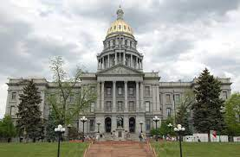
REPORT CARDS ON CHILD & YOUTH
SEX TRAFFICKING
Southern Colorado HTTF Meeting
October 11, 2022

Slide 2
Protected Innocence Challenge Project
2011
2011-2019
Nat'l average: 59.1%;
Colorado: 58%
2019
Nat’l average: 84.7%
Colorado: 90%
Notes:
PIC was Shared Hope’s initial project for mobilizing anti-trafficking legislative change at the state level. Created in 2011, the original Framework was composed of 41 components address fundamental trafficking laws, offender accountability, victim protections, and law enforcement tools. Under the first Report Card, Colorado received a 58%; by 2019 (the final year of the PIC Report Card), the score raised to a 90.

Slide 3
Despite significant progress, national average on victim protections is:
71.4%
Colorado’s score under this section was: 81%
Notes:
Over 9 years of grading under the PIC framework, significant legislative advancements occurred nationally. By 2019, every state had a child sex trafficking law and some statutory protections for child survivors; however, most of the growth impacted criminal accountability for offenders rather than protections and services for child and youth survivors. This was depicted in the disparity between the national average score on the framework as a whole (84.7%) and the section of the framework examining just victim protections (71.4%).

Slide 4
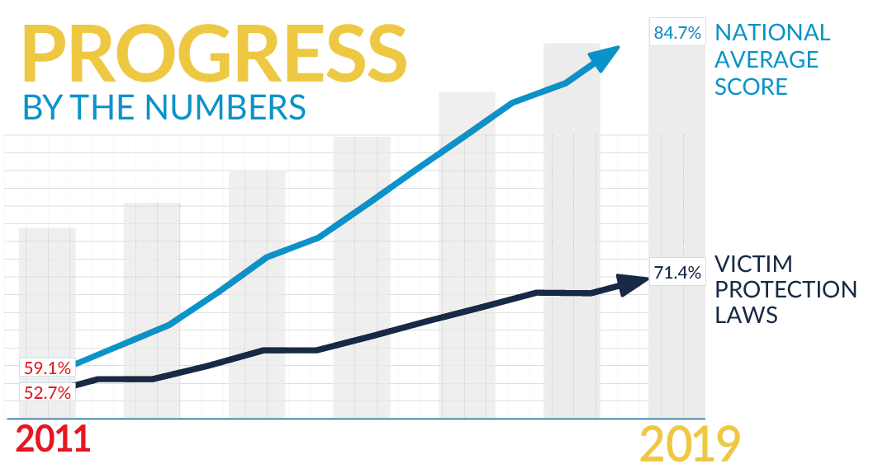
disproportional growth between offender accountability & victim protections
what does an "A" mean?
current grades fail to fully reflect identification & response to youth survivors
what is progress without victim protections & well-being?
Notes:
Recognizing that a majority of states received an A or B grade in 2019, Shared Hope’s Policy Team was confronted with the reality of what an “A” grade meant if progress wasn’t prioritizing victim protections and survivor well being.

Slide 5
UNCOVERING DISPARATE GROWTH
1
Seeking Justice
3
Technical Assistance
challenges in passing legislation to increase availability of victim protections
2018 & 2019 research on non-crim protections & responses
2
VOI Research
4
Research to Action
national research on intersection of sex trafficking victimization & offender conduct
workgroup series to obtain insights & input from the field
Notes:
The Policy Team embarked on a two-year process to ascertain what changes needed to be made to spur growth in the area needed the most: protections and access to services for survivors. We pulled together findings from research on laws related to non-criminalization (i.e. Safe Harbor) and victim-offender intersectionality (i.e. “bottoms”), as well as lessons learned in the course of providing technical assistance in the field . Further, we gathered and engaged a multi-disciplinary group of 200+ stakeholders (both those with lived experience and allied professionals) to gain input from the field through in-person workgroup meetings, interviews, and surveys.

Slide 6
SEEKING JUSTICE
19
still have laws allowing minors to be prosecuted for prostitution.
STATES
13
9 non-crim laws have restrictions
extend non-crim protections to offenses beyond prostitution
STATES
11
with non-crim laws do not require availability of specialized services
4 do not provide any services
STATES
Notes:
Findings from Seeking Justice research (current as of 2019)

Slide 7
VICTIM OFFENDER INTERSECTIONALITY
4
2
have laws prohibiting minor trafficking victims from being prosecuted for human trafficking
have laws prohibiting adult trafficking victims from being prosecuted for human trafficking
12
have laws allowing victims to raise an affirmative defense at trial
STATES
STATES
STATES
GOALS
recognize trauma behaviors
create pathways to services
identify victimization
hold true offenders accountable
Notes:
Findings from VOI research (current as of 2020)

Slide 8
"As a former social worker at an elementary school, there were children at my school, 12, 13 year old, and some of these children look older than me. They were much more, I mean, definitely sophisticated, developed... I would not have known these children were 12 instead of 19 or 20."
-former state legislator (AZ)
"I understand not wanting to charge a juvenile with a crime, but this law discourages juveniles from continuing prostitution as a lifestyle. This is a bill to legalize juvenile prostitution."
-current state legislator (ME)
"So, she's uncomfortable for something that she voluntarily went to, voluntarily took her top off, and paid? . . . I do find that the victims in this case in particular were more an aggressor . . . they were certainly selling things monetarily that it's against the law for even an adult to sell . . "
-current Kansas District Ct judge
Notes:
Insights gained from the field through the provision of technical assistance.

Slide 9
RESEARCH TO ACTION WORKGROUP
2018-2020
In person work group & consultation meetings w/ 200+ lived experience experts & field professionals
statutory research & analysis, review of best practices, review of implementation outcomes
stakeholder survey
& vettor process (State Attorneys General, Governors’ Offices, Statewide Coordinators)
Notes:
Research to Action workgroup/process
Stakeholder survey– provided a draft review of the framework for input and final feedback and approval.

Slide 10
Research to Action Stakeholder Feedback
Clear & meaningful buyer accountability to support paradigm shift
robust victim witness protections for all minor victims
Protections must extend to older youth & children/youth experiencing policy victimization
Comprehensive stakeholder training & use of MDTs result in increased identification & safe/effective responses
True non-crim = protections from punishment for offenses beyond prostitution
Notes:
Outcomes from Research to Action
MDTS=multi-disciplinary teams
Poly-victimization= survivors of both sex and labor trafficking

Slide 11
SUCCESS AS DEFINED UNDER
ADVANCED FRAMEWORK
Protective Responses
Identification
State law provides clear non-criminalization protections for child/youth survivors & access to comprehensive, appropriate & elective services for youth. Children & non-offending caregivers are supported & provided decision-making power.
State law broadly defines child & youth sex trafficking victim for purpose of opening avenues to protection, care & services. Agencies are empowered through training & funding to identify & support children and youth w/o restrictions.
Protections for Older Youth
Training & Collaboration
State law expands definitions of child & youth sex trafficking victims for purposes of removing disparities in services, care & protection for older youth. Transition age youth are afforded services & care unique to their needs w/o restrictions.
State law supports access to comprehensive training for child welfare, JJ, LEO & prosecutors to ensure provision of trauma-informed responses. State law requires use of MDTs to share cost & time demands & facilitate survivor-centered response.
Notes:
The gathered information was translated into a revised framework centered on “success” being defined by the outcomes and well-being of survivors.
Advanced Framework includes 4 key priority areas spread across 40 components: (1) Protective Responses: ensuring comprehensive protective responses for survivors, including non-criminalization protections, access to specialized services both in and outside of state child serving systems, funding for community-based responses and services, reducing collateral consequences for system-involvement; (2) Identification: ensuring stakeholders are equipped to make appropriate, timely, and non-harmful identifications of trafficking victimization through trauma-informed screening and stakeholder training; (3) Protections for Older Youth: protections provided for through statute eliminate the bright line of 18 to expand access to services and care for all young people, including emerging adults; and (4) Training and Collaboration: state law supports better outcomes for survivors by ensuring stakeholders are equipped to respond (e.g., training for all stakeholder groups, mandatory MDT responses).

Slide 12
POLICY PRIORITIES
Non-Criminalization:
Prostitution law does not apply to minors
Child sex trafficking victims are insulated from prosecution for offenses related to victimization
Raise the Age (juvenile justice)
Comprehensive vacatur
Access to services outside punitive system
Non-offending caregivers are supported, not punished
OFFENDER
ACCOUNTABILITY:
Agency Responses
Child welfare can response to all CSE minors regardless of offender & immigration status.
Child serving agencies mandate training & are appropriately funded
Children & youth can access community-based services
Special protections, support & care for transition age youth w/o barriers
Child sex trafficking law clearly applies to buyers w/o requiring 3rd party control
Sex trafficking & commercial sexual exploitation laws applies to minors equally, regardless of age
Accountability positively impacts survivor’s trajectory (restitution, victim services fund)
Victim-Witness Protections
Ex parte civil orders of protection
Closed circuit TV
Access to victim advocate
Elimination of Statute of Limitations (civil & criminal)
Hearsay exception
Crime victim’s compensation w/o barriers
Restitution & civil remedies
Notes:
Underlined policies were carried over from the PIC framework and modified.

Slide 13
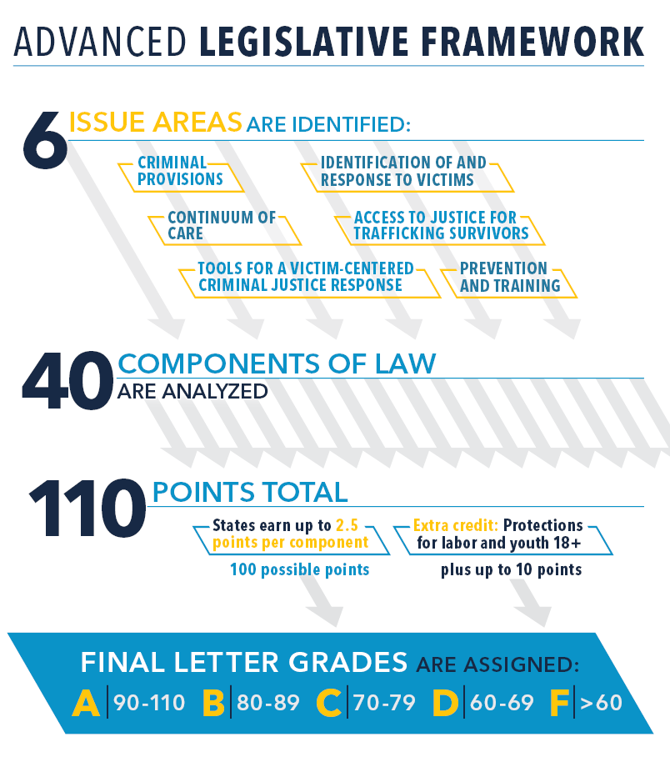
REPORT CARDS & GRADES
JAN-JULY
TA & leg advocacy & state bill tracking
AUGUST
Review & grading of state legislation
SEPT.-OCT.
AG & Governor vettor engagement
NOVEMBER 1, 2022
Report Cards Release
Notes:
Advanced Legislative Framework:
6 Issue Areas: Criminal Provisions (laws that apply to buyers, traffickers, and facilitators), Identification and Response to Victims, Continuum of Care, Access to Justice for Trafficking Survivors, Tools for a Victim-Centered Criminal Justice Response; and Prevention and Training.
Process:
From January-July, Team tracks legislation in all 50 states + D.C. and provides technical assistance to state policymakers and advocates.
Team grades states on new legislation/state laws and incorporates into Framework and individual state Analysis & Recommendations reports.
Team sends draft reports to all state AGs, Governors, and state HT coordinators for review and feedback.
November: release of Report Cards.

Slide 14
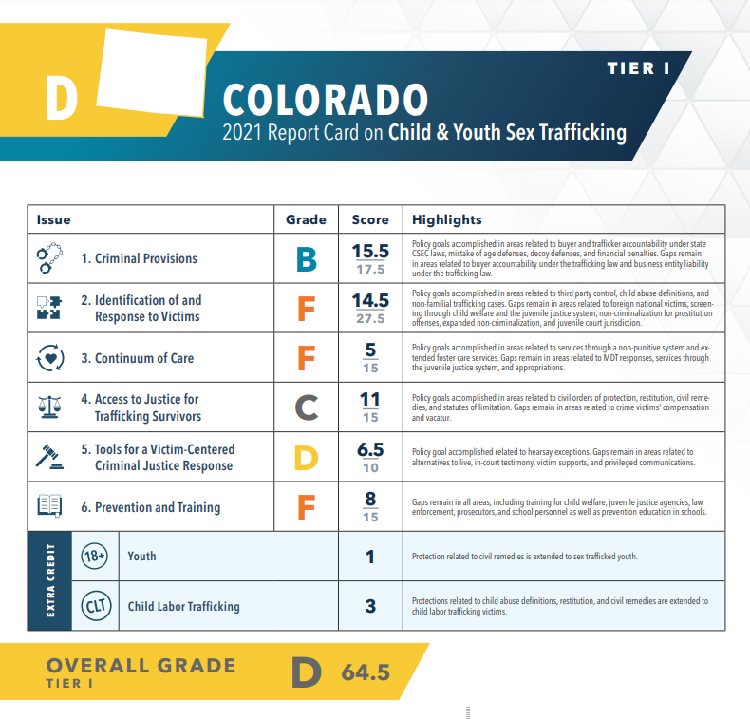
2021
Report Card
Colorado received a 64.5 (D)
National average: 47
Tier I State
#6 Overall
Highest scoring section: Criminal Provisions (offender accountability)

Slide 15
Policy Team
Policy@sharedhope.org
CONTACT
Accessing Report Cards & Policy Materials
Previous: https://reportcards.sharedhope.org
2022: https://act.sharedhope.org/vpbPHOe
Text REPORT CARD to 52886

